Slide 1
Unit-5 Reasoning

Slide 2
Contents
Inference in First-Order Logic,
Propositional vs. First-Order Inference,
Unification and First-Order Inference,
Forward Chaining,
Backward Chaining,
Resolution,
Knowledge Representation,
Ontological Engineering,
Categories and Objects,
Events,
Mental Objects and Modal Logic,
Reasoning Systems for Categories,
Reasoning with Default Information

Slide 3
Inference in First-Order Logic
Inference in First-Order Logic is used to deduce new facts or sentences from existing sentences.
First-Order logic does not only use predicate and terms for making atomic sentences but also uses another way, which is equality in FOL. For this, we can use equality symbols which specify that the two terms refer to the same object.
Example: Brother (John) = Smith.
As in the above example, the object referred by the Brother (John) is similar to the object referred by Smith. The equality symbol can also be used with negation to represent that two terms are not the same objects.
Example: ￢(x=y) which is equivalent to x ≠y.

Slide 4
FOL inference rules for quantifier
Universal Generalization
Universal Instantiation
Existential Instantiation
Existential introduction

Slide 5
FOL inference rules for quantifier
Universal Generalization
Universal generalization is a valid inference rule which states that if premise P(c) is true for any arbitrary element c in the universe of discourse, then we can have a conclusion as ∀ x P(x).
This rule can be used if we want to show that every element has a similar property.
In this rule, x must not appear as a free variable.
Example: Let's represent, P(c): "A byte contains 8 bits", so for ∀ x P(x) "All bytes contain 8 bits.", it will also be true.

Slide 6
FOL inference rules for quantifier
Universal Instantiation
Universal instantiation is also called as universal elimination or UI is a valid inference rule. It can be applied multiple times to add new sentences.
The new KB is logically equivalent to the previous KB.
As per UI, we can infer any sentence obtained by substituting a ground term for the variable.
The UI rule state that we can infer any sentence P(c) by substituting a ground term c (a constant within domain x) from ∀ x P(x) for any object in the universe of discourse.
IF "Every person like ice-cream"=> ∀x P(x) so we can infer that "John likes ice-cream" => P(c)

Slide 7
"All kings who are greedy are Evil." So let our knowledge base contains this detail as in the form of FOL:
∀x king(x) ∧ greedy (x) → Evil (x),
So from this information, we can infer any of the following statements using Universal Instantiation:
King(John) ∧ Greedy (John) → Evil (John),
King(Richard) ∧ Greedy (Richard) → Evil (Richard),
King(Father(John)) ∧ Greedy (Father(John)) → Evil (Father(John)),

Slide 8
Existential Instantiation:
Existential instantiation is also called as Existential Elimination, which is a valid inference rule in first-order logic.
It can be applied only once to replace the existential sentence.
The new KB is not logically equivalent to old KB, but it will be satisfiable if old KB was satisfiable.
This rule states that one can infer P(c) from the formula given in the form of ∃x P(x) for a new constant symbol c.
The restriction with this rule is that c used in the rule must be a new term for which P(c ) is true.
From the given sentence: ∃x Crown(x) ∧ OnHead(x, John),
So we can infer: Crown(K) ∧ OnHead( K, John), as long as K does not appear in the knowledge base.
The above used K is a constant symbol, which is called Skolem constant.
The Existential instantiation is a special case of Skolemization process.

Slide 9
Existential instantiation
Existential instantiation is also called as Existential Elimination, which is a valid inference rule in first-order logic.
It can be applied only once to replace the existential sentence.
The new KB is not logically equivalent to old KB, but it will be satisfiable if old KB was satisfiable.
This rule states that one can infer P(c) from the formula given in the form of ∃x P(x) for a new constant symbol c.
The restriction with this rule is that c used in the rule must be a new term for which P(c ) is true.
From the given sentence: ∃x Crown(x) ∧ OnHead(x, John),
So we can infer: Crown(K) ∧ OnHead( K, John), as long as K does not appear in the knowledge base.
The above used K is a constant symbol.

Slide 10
Existential introduction
An existential introduction is also known as an existential generalization, which is a valid inference rule in first-order logic.
This rule states that if there is some element c in the universe of discourse which has a property P, then we can infer that there exists something in the universe which has the property P.
Example: Let's say that, "Priyanka got good marks in English." "Therefore, someone got good marks in English."

Slide 11
Propositional vs. First-Order Inference
Propositional Logic converts a complete sentence into a symbol and makes it logical whereas in First-Order Logic relation of a particular sentence will be made that involves relations, constants, functions, and constants.
The limitation of PL is that it does not represent any individual entities whereas FOL can easily represent the individual establishment that means if you are writing a single sentence then it can be easily represented in FOL.
PL does not signify or express the generalization, specialization or pattern for example ‘QUANTIFIERS’ cannot be used in PL but in FOL users can easily use quantifiers as it does express the generalization, specialization, and pattern.

Slide 12
Unification and First-Order Inference
Unification is a key component of all first-order inference algorithms. It returns fail if the expressions do not match with each other. The substitution variables are called Most General Unifier or MGU.
John likes all kind of food.
Apple and vegetable are food
Anything anyone eats and not killed is food.
Anil eats peanuts and still alive
Harry eats everything that Anil eats. Prove by resolution that:
John likes peanuts.

Slide 13
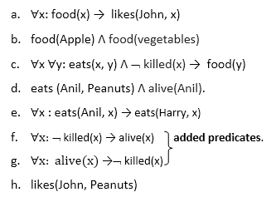
Step-1: Conversion of Facts into FOL
In the first step we will convert all the given statements into its first order logic.

Slide 14
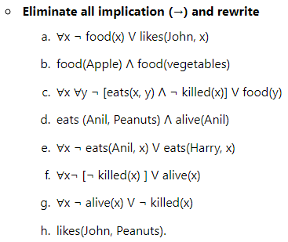
Step-2: Conversion of FOL into CNF

Slide 15
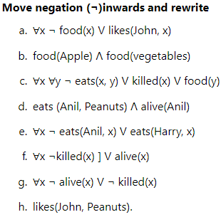

Slide 16
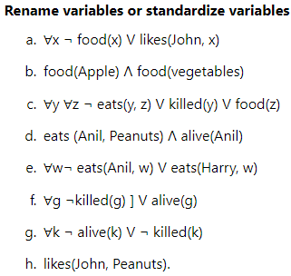

Slide 17
Eliminate existential instantiation quantifier by elimination. In this step, we will eliminate existential quantifier ∃, and this process is known as Skolemization. But in this example problem since there is no existential quantifier so all the statements will remain same in this step.

Slide 18
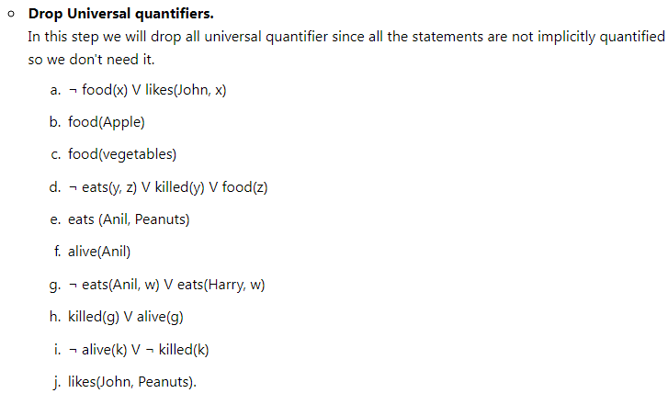

Slide 19
Distribute conjunction ∧ over disjunction ¬. This step will not make any change in this problem.
Step-3: Negate the statement to be proved
In this statement, we will apply negation to the conclusion statements, which will be written as ¬likes(John, Peanuts)
Step-4: Draw Resolution graph:

Slide 20
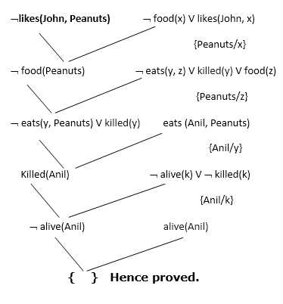
In the first step of resolution graph, ¬likes(John, Peanuts) , and likes(John, x) get resolved(canceled) by substitution of {Peanuts/x}, and we are left with ¬ food(Peanuts)
In the second step of the resolution graph, ¬ food(Peanuts) , and food(z) get resolved (canceled) by substitution of { Peanuts/z}, and we are left with ¬ eats(y, Peanuts) V killed(y) .
In the third step of the resolution graph, ¬ eats(y, Peanuts) and eats (Anil, Peanuts) get resolved by substitution {Anil/y}, and we are left with Killed(Anil) .
In the fourth step of the resolution graph, Killed(Anil) and ¬ killed(k) get resolve by substitution {Anil/k}, and we are left with ¬ alive(Anil) .
In the last step of the resolution graph ¬ alive(Anil) and alive(Anil) get resolved.

Slide 21
Forward Chaining, Backward Chaining
Inference engine:
The inference engine is the component of the intelligent system in artificial intelligence, which applies logical rules to the knowledge base to infer new information from known facts. The first inference engine was part of the expert system. Inference engine commonly proceeds in two modes, which are:
Forward chaining
Backward chaining

Slide 22
Forward Chaining
Forward chaining is also known as a forward deduction or forward reasoning method when using an inference engine. Forward chaining is a form of reasoning which start with atomic sentences in the knowledge base and applies inference rules in the forward direction to extract more data until a goal is reached.
The Forward-chaining algorithm starts from known facts, triggers all rules whose premises are satisfied, and add their conclusion to the known facts. This process repeats until the problem is solved.
Properties of Forward-Chaining:
It is a down-up approach, as it moves from bottom to top.
It is a process of making a conclusion based on known facts or data, by starting from the initial state and reaches the goal state.
Forward-chaining approach is also called as data-driven as we reach to the goal using available data.
Forward -chaining approach is commonly used in the expert system, such as CLIPS, business, and production rule systems

Slide 23
Example:
"As per the law, it is a crime for an American to sell weapons to hostile nations. Country A, an enemy of America, has some missiles, and all the missiles were sold to it by Robert, who is an American citizen."
Prove that "Robert is criminal."
To solve the above problem, first, we will convert all the above facts into first-order definite clauses, and then we will use a forward-chaining algorithm to reach the goal.

Slide 24
Facts Conversion into FOL:
It is a crime for an American to sell weapons to hostile nations. (Let's say p, q, and r are variables) American (p) ∧ weapon(q) ∧ sells (p, q, r) ∧ hostile(r) → Criminal(p) ...(1)
Country A has some missiles. ?p Owns(A, p) ∧ Missile(p). It can be written in two definite clauses by using Existential Instantiation, introducing new Constant T1. Owns(A, T1) ......(2) Missile(T1) .......(3)
All of the missiles were sold to country A by Robert. ?p Missiles(p) ∧ Owns (A, p) → Sells (Robert, p, A) ......(4)
Missiles are weapons. Missile(p) → Weapons (p) .......(5)
Enemy of America is known as hostile. Enemy(p, America) →Hostile(p) ........(6)
Country A is an enemy of America. Enemy (A, America) .........(7)
Robert is American American(Robert). ..........(8)

Slide 25

Forward chaining proof:
Step-1:
In the first step we will start with the known facts and will choose the sentences which do not have implications, such as: American(Robert), Enemy(A, America), Owns(A, T1), and Missile(T1). All these facts will be represented as below.

Slide 26
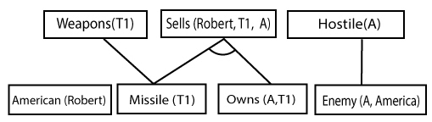
Step-2:
At the second step, we will see those facts which infer from available facts and with satisfied premises.
Rule-(1) does not satisfy premises, so it will not be added in the first iteration.
Rule-(2) and (3) are already added.
Rule-(4) satisfy with the substitution {p/T1}, so Sells (Robert, T1, A) is added, which infers from the conjunction of Rule (2) and (3).
Rule-(6) is satisfied with the substitution(p/A), so Hostile(A) is added and which infers from Rule-(7).

Slide 27
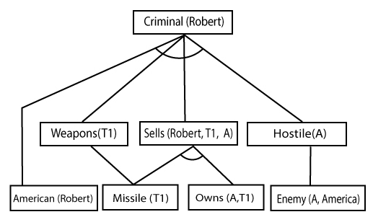
Step-3:
At step-3, as we can check Rule-(1) is satisfied with the substitution {p/Robert, q/T1, r/A}, so we can add Criminal(Robert) which infers all the available facts. And hence we reached our goal statement.

Slide 28
Backward Chaining:
Backward-chaining is also known as a backward deduction or backward reasoning method when using an inference engine. A backward chaining algorithm is a form of reasoning, which starts with the goal and works backward, chaining through rules to find known facts that support the goal.

Slide 29
Properties of backward chaining:
It is known as a top-down approach.
Backward-chaining is based on modus ponens inference rule.
In backward chaining, the goal is broken into sub-goal or sub-goals to prove the facts true.
It is called a goal-driven approach, as a list of goals decides which rules are selected and used.
Backward -chaining algorithm is used in game theory, automated theorem proving tools, inference engines, proof assistants, and various AI applications.
The backward-chaining method mostly used a depth-first search strategy for proof.

Slide 30
Example
American (p) ∧ weapon(q) ∧ sells (p, q, r) ∧ hostile(r) → Criminal(p) ...(1) Owns(A, T1) ........(2)
Missile(T1)
?p Missiles(p) ∧ Owns (A, p) → Sells (Robert, p, A) ......(4)
Missile(p) → Weapons (p) .......(5)
Enemy(p, America) →Hostile(p) ........(6)
Enemy (A, America) .........(7)
American(Robert). ..........(8)

Slide 31

Step-1:
At the first step, we will take the goal fact. And from the goal fact, we will infer other facts, and at last, we will prove those facts true. So our goal fact is "Robert is Criminal," so following is the predicate of it.

Slide 32
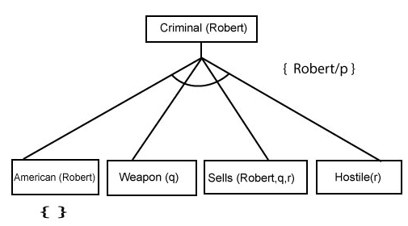
Step-2:
At the second step, we will infer other facts form goal fact which satisfies the rules. So as we can see in Rule-1, the goal predicate Criminal (Robert) is present with substitution {Robert/P}. So we will add all the conjunctive facts below the first level and will replace p with Robert.
Here we can see American (Robert) is a fact, so it is proved here.

Slide 33
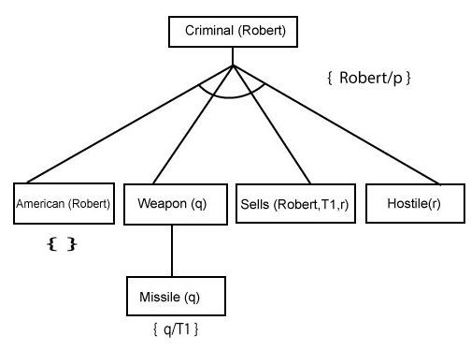
Step-3:t At step-3, we will extract further fact Missile(q) which infer from Weapon(q), as it satisfies Rule-(5). Weapon (q) is also true with the substitution of a constant T1 at q.

Slide 34
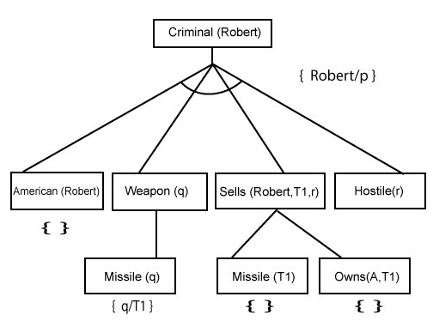
Step-4:
At step-4, we can infer facts Missile(T1) and Owns(A, T1) form Sells(Robert, T1, r) which satisfies the Rule- 4, with the substitution of A in place of r. So these two statements are proved here.

Slide 35
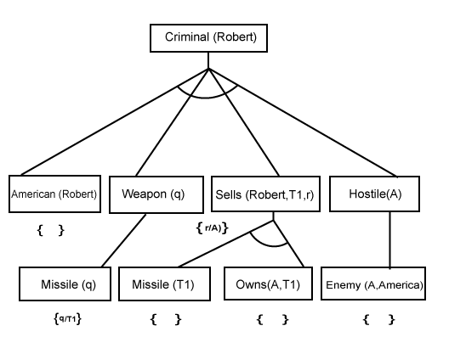
Step-5:
At step-5, we can infer the fact Enemy(A, America) from Hostile(A) which satisfies Rule- 6. And hence all the statements are proved true using backward chaining.

Slide 36
Resolution

Slide 37
Ontological Engineering
Ontology Engineering is “the set of activities that concern the ontology development process, the ontology life cycle, and the methodologies, tools and languages for building ontologies” .
It provides “a basis of building models of all things in which computer science is interested”

Slide 38
Ontological Engineering
An ontology is a set of concepts and categories in a subject area or domain that possesses the properties and relations between them.
Ontological Modeling can help the cognitive AI or machine learning model by broadening its' scope.
They can include any data type or variation and set each diver data to a specific task.

Slide 39
Ontological Engineering
An entity ontologically depends on another entity if the first entity cannot exist without the second entity.
Ontologically independent entities, on the other hand, can exist all by themselves.
For example, the surface of an apple cannot exist without the apple and so depends on it ontologically.

Slide 40
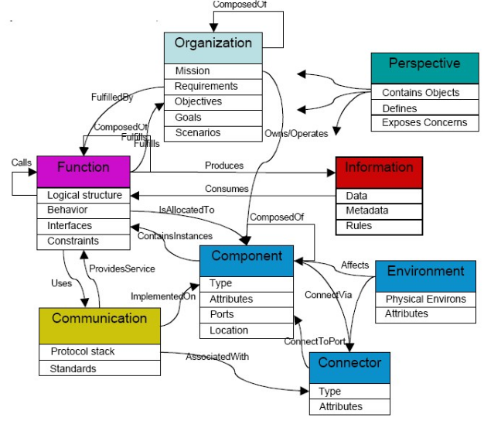
Ontological Engineering

Slide 41
Ontological Engineering
physical objects, abstract objects, time, locations, actions, events, beliefs.
Decisions made on imperfect representations can be wrong.
We must choose the representation with this in mind. Selecting a particular representation means making an ontological commitment.

Slide 42
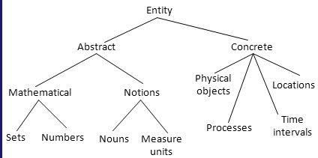
Ontological Engineering

Slide 43
KB and Database
The KB in a program can be represented as a relational database.
The larger the KB, the better its structure must be thought from the start.
The database should be consistent in terms of connectivity - if something changes in one place, the change must be reflected everywhere else.
The database must be unified, meaning that we must be able to use its various components within the same framework. A particular application may require more than 1 component.

Slide 44
Expert Systems
Programs that incorporate knowledge of a particular domain and that can help with making decisions.
They often emerge from the retirement of a human expert that takes time and effort to replace.
Basic components: a knowledge base KB and an inference system.
The expertise is organized in rules of type "if-then" by a human expert.
For classification/diagnosis problems this often results in a tree.

Slide 45
General Functionality
The user seeks a diagnosis or goal (car failure).
The system asks a question, often with a yes/no answer.
If this answer is not sufficient to determine the diagnosis completely, another question will be asked.
Some of the systems can allow for an undetermined answer (I don't know) and they can adapt to that,
The answer might be given with a certain probability.
In general they avoid asking for irrelevant input.

Slide 46
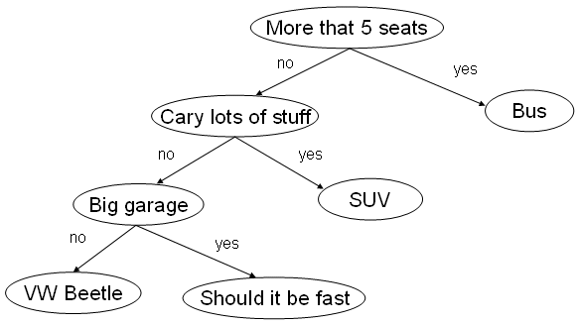
Example

Slide 47
Semantic Networks
A graph notation for representing knowledge. The nodes are concepts and the edges are relations between them.
Definitional networks - the relations are subtype or is-a.
Assertional networks are designed to assert propositions.
Implicational networks use implication to connect nodes.
Executable networks can include procedures.
Learning networks build or extend their representations by acquiring knowledge from examples.
Hybrid networks combine two or more of the previous techniques.

Slide 48
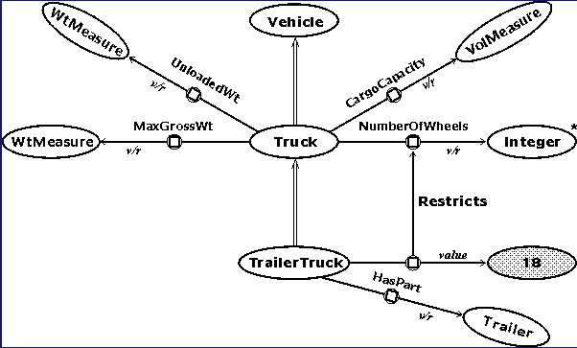
Example - Definition Network

Slide 49
Categories and Objects
Organizing the objects in categories.
Some reasoning takes places at the level of categories.
"I want to eat an apple."
Apple(x), or Member(x, Apple) and Subset(Apple, Food).
The categories form a hierarchy where each class inherits the properties of the parent, or simply a network (apples are both food and fruit).
The categories of a class compose a taxonomy.

Slide 50
Partitioning
Two or more categories are disjoint if they are mutually exclusive (male/female).
A decomposition of a class into categories is called exhaustive if each object of the class must belong to at least one category
living = {animal, vegetable, fungi, bacteria}
A partition is a an exhaustive decomposition of a class into disjoint subsets.
student = {undergraduate, graduate}
Related problem: clustering. Given a set of objects, find an appropriate category for each of them. The categories may not be predefined.

Slide 51
Attributes
Composition: PartOf(nose, face).
Some categories can be defined as rules:
Biped(x) => b1, b2 (Leg(b1) & Leg(b2) & PartOf(b1, x) & PartOf(b2, x) & !equal(b1, b2).
Prime(n) <=> (Number(n) & n != 1 & d (equal(n%d, 0) => (equal(d, 1) | (equal(d, n))))
Measurements: Length(x), Price(x), etc. These are functions, not predicates.
Things: 3 apples. Stuff: water, more water, some quantity of water.

Slide 52
Situations
Situation: a predicate that is true at a particular moment in time. They may also have a specific location. A particular state of the system.
Drives(Mary, car, I90, 03/15/096)
Fluent: predicates and functions that can change from a moment to another. Happy(x).
Atemporal or eternal predicates: Warrior(A) will be true for as long as the object A exists. Alive(A) may change from a moment to the next.

Slide 53
Actions
Predicates that represent changes in the environment. The involve at least a subject, often one or more objects.
eat(x, y), sleep(x), talk(x), say(x, y)
When an action is part of a situation, it can result in other predicates becoming true at a later moment in time.
(Eat(x, y, t) & Apple(y)) => !Hungry(x, t+1)
Projection: the agent can use some rules to predict the outcome of its possible actions and choose the appropriate one. This is done by planning.

Slide 54
Situation Calculus
Description of an action:
Possibility rule (precondition): a sentence that specifies when an action is possible.
has(x, y, s) & apple(y) => Possible(eat(x, y), s)
Effect rule (postcondition): a sentence that describes the consequences of an action.
eat(x, y, s) => !exist(y, s+1)
collect(x, y, s) => has(x, y, s+1)
Frame problem: the collection of things / predicates that don't change.

Slide 55
Time and Events
In time-based calculus the fluents are valid for particular moments in time instead of in a particular situation.
A fluent is true at a particular point in time if it was initiated or caused by an event in the past, and was not terminated by another event in the meantime.
Initiates(e, f, t), e-event, f-fluent, t-time.
Terminates(e, f, t). Happens(e, t). Clipped(f, t, t2)
T(f, t2) <=> e, t (Happens(e, t) & Initiates(e, f, t) & (t < t2) & !Clipped(f, t, t2) )
Clipped(f, t, t2) <=> e, t1 (Happens(e, t1) & Terminates(e, f, t1) & (t < t1) & (t1 < t2) )

Slide 56
Mental Processes
Does an agent know that he knows something?
We need to represent the fact that an agent believes something to be true or knows something to be true.
We can make inferences about things an agent believes, things that the agent knows, and things that are true, but the combinations are not always possible.
The inferences can be made only if the agent is a logical agent capable of reasoning.
This is called modal logic.

Slide 57
Beliefs
Believes(x, P(a)) x believes that P(a) is true.
Inferences are not obvious.
Believes(x, P(a)) & (a = b) does not imply that Believes(x, P(b)) is also true.
We can apply reasoning within the system of beliefs for a logical agent:
Believes(x, P(a)) & Believes(x, P(y) => Q(y)) can imply that Believes(x, Q(a)).
We can't apply MP if the agent doesn't know or believe that P(y) => Q(y).

Slide 58
Knowledge and Belief
Knows(x, P(a)) is similar to Believes, but the fact P(a) must be true.
KnowsWhether(x, P(a)) means Knows(x, P(a)) | Knows(x, !P(a)).
KnowsWhat(x, EyeColor(a)) means that y Color(y) & Knows(x, (EyeColor(a) = y)).
Believes(x, P(a)) & Knows(x, P(y)=>Q(y)) implies Believes(x, Q(a)).
Knows(x, P(a)) & Believes (x, P(y)=>Q(y)) implies Believes(x, Q(a)).
Knows(x, P(a)) & Knows(x, P(y)=>Q(y)) implies Knows(x, Q(a)).

Slide 59
Fuzzy Logic
First author: Lotfi Zadeh, University of California at Berkley, 1965.
Def. Part of logic dealing with approximate reasoning, derived from the fuzzy set theory.
A fuzzy set is one to which elements belong with a given percentage.
In fuzzy logic the truth values belong to the interval [0, 1] representing a percentage of truth.
It is better suited to represent imprecise information/attributes from the real world and to make appropriate inferences.

Slide 63
Categories and Objects
Events,
Mental Objects and Modal Logic,
Reasoning Systems for Categories,
Reasoning with Default Information

